Slide 1





Machine Learning
TECH TALKS
Ravindra Nikam
Presenter of the topic

Slide 2



ML in a Nutshell
Introduction
AI/ML in daily life
Applications
AI/ML/Deep Learning
Types of Target Variables
Types of Machine Learning
Supervised
Unsupervised
Reinforcement Learning
Deep Learning
AI/ML demo
Notes:
Important suggestion,
We know these are challenging times. ISP may struggle sevice continuity, we may face power outage.
Stay connected to talk session and with available backup option we reconnect session immediately

Slide 3
AI & Machine Learning
Google or Bing
Spam filter/detection
Facebook or Apple’s photoapp.
Tidy your house
Building anything that you or I can do……….AI, Neural NW
Machine Learning is the science of getting computers to learn, without being explicitly programmed.
Notes:
We cannot create thousand programmes to give product recommendation
Or we can not keep giving helicopter instructions continuously. Machine has to learn on its own

Slide 4
AI & Machine Learning
Machine Learning
- Grew out of work in AI
- New capability for computers
Examples:
Database mining Large datasets from growth of automation/web. E.g., Web click data, medical records, biology, engineering
Applications can’t program by hand. E.g., Autonomous helicopter, handwriting recognition, most of Natural Language Processing (NLP), Computer Vision.
Self-customizing programs E.g., Amazon, Netflix product recommendations
Understanding human learning (brain, real AI).
Notes:
Why machine learning/AI now?
Computer power
Large scale data available on internet

Slide 5




AI/ML in your daily life
Social Media
Retail
E-Commerce
Next Gen AMS

Slide 6







Infosys clients WITH ML tools
Artificial Intelligence
Machine Learning
Deep Learning
Notes:
AI – find shortest distance between cities
However scientists wanted to solve more challenging unsolved problems e.g healthcare, transport, computer vision, language processing.
We found Machine learning give interesting and good results

Slide 7
Types/Techniques of Machine Learning
Machine Learning:
Predictive Analytics
Training/historical/experience data: very large good quality data sets detects the pattern and create a model which helps to make predictions for the new data
accuracy of the model
Types of machine learning:-
1. Supervised machine learning --- learns under human supervision---
self driving car:---driving experiences shared by humans(training data)
price of house(Target Variable):--sq. ft.m no. of bedroom, location etc.
e-mail Spam/not Spam: yes/no. true/false
Notes:
Now moving to theoretical part
Believe me many people avoid theory, however if listen carefully the examples, I bet you can easily grasp high level ML concepts

Slide 8

Types of Machine Learning
Types of Target Variable:
Continuous numeric variable: regression deals with numeric variable
Discrete Variable: classification deals with discrete variable
Regression and Classification:
Regression:
Simple linear regression:
y(EDT) =mx(distance) + c(pizza making time)---->
Multiple Linear Regression:
more than input variable
price of house(Target Variable):--sq. ft.m no. of bedroom, location etc.
P = m1x1+m2x2+m3x3+...+c

Slide 9
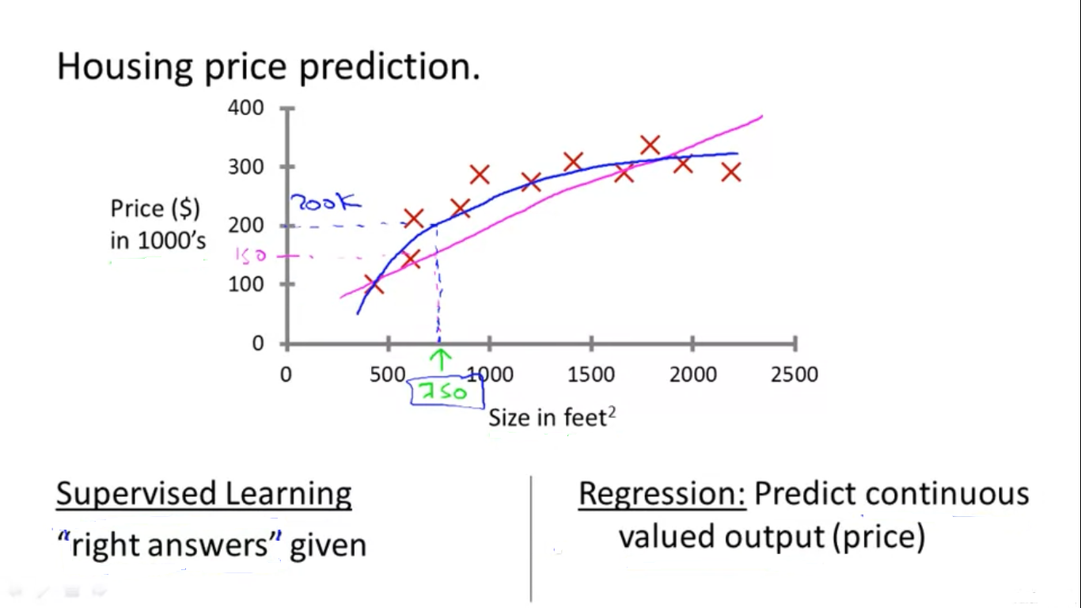
Supervised Learning Explained - Regression
Notes:
Quadratic or second order polynomial

Slide 10
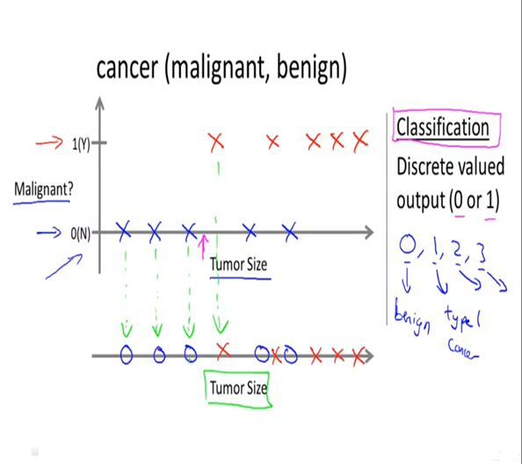
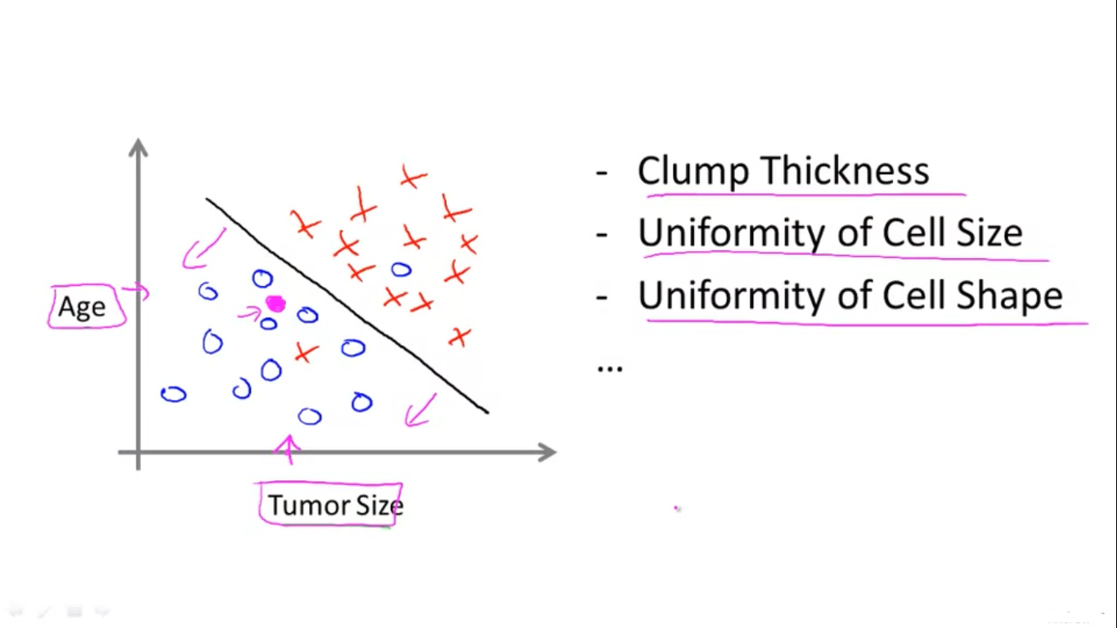
Supervised Learning Explained - Classification
Notes:
Malignant Harmful
Benign Harmless
Healthcare industry – critical diagnosis
To check accuracy of model we have indicators like precision, recall, accuracy, F1 score etc

Slide 11
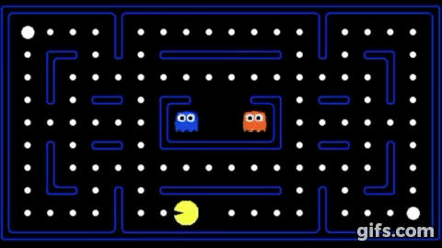

Types of Machine Learning
Classification:
Support Vector machine
Decision tree
K-nearest neighbor
Logistic regression
2. Unsupervised machine learning
online news categorization
Clustering and Association Mining
3. Reinforcement machine Learning:
Reinforcement Learning(RL) is a type of machine learning technique that enables an agent to learn in an interactive environment by trial and error using feedback from its own actions and experiences.
4. Deep learning:
Artificial neural Network
CNN: Convolutional-----images, vision, detecting & RNN: Recurrent----NLP, time series data,
Notes:
Pacman Ghost Food items Agent
Identify object from image, dynamic gesture recognition from video

Slide 12
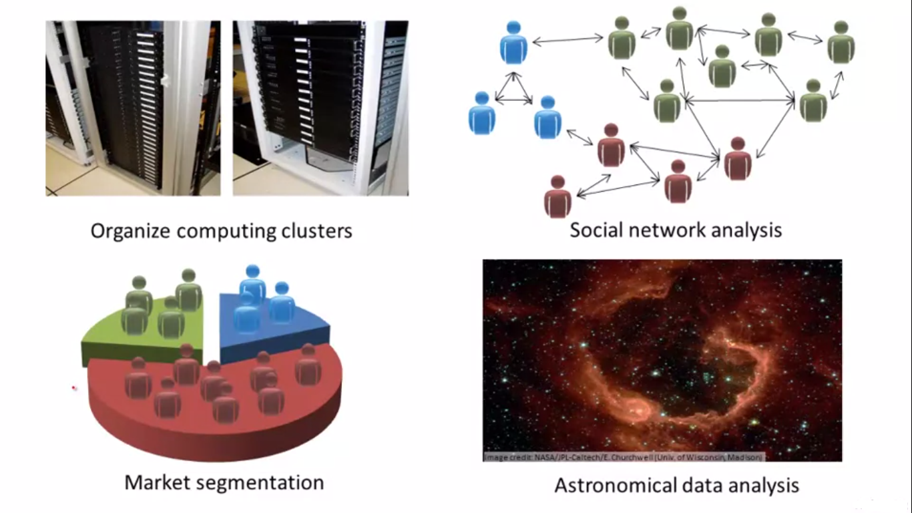
Unsupervised Learning Explained
news.google.com
organize computing clusters
social network analysis
market segmentation
astronomical data analysis
Notes:
Gender
In social network find how people are related to each other
How galaxies are formed

Slide 13
AI & ML Demo
AI Demo – Tree planting drone
ML Demo – Autonomous flying helicopter
AI Demo – Neural Text to Speech / Neural Deep AI
Notes:
Use mixed reality to create hologram
Then use Speech to Text to get speech
Then translate text to Japanese speech
Finally using Neural network, render keynote Japanese sounding with same tone and accent
Transliteration process of expressing sound of how word is pronounced in source language. Doesnot give meaning of word
What’s the difference between a transliteration and a translation?
A. A translation tells you the meaning of words in another language. A transliteration doesn’t tell you the meaning of the words, but it helps you pronounce them. Transliteration changes the letters from one alphabet or language into the corresponding, similar-sounding characters of another alphabet.

Slide 14
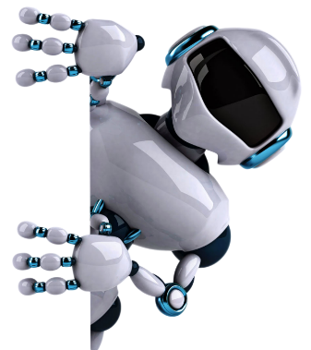

THANK YOU

